Slide 1

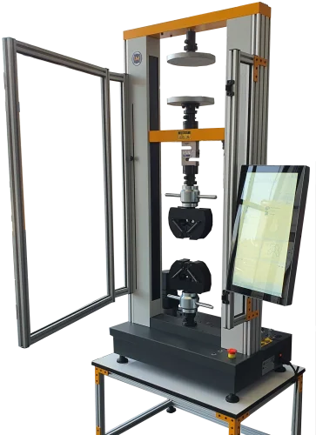

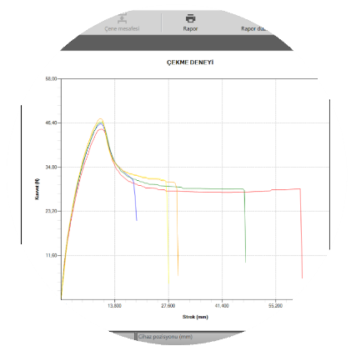
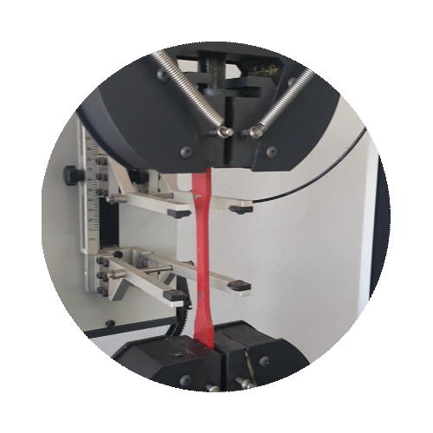
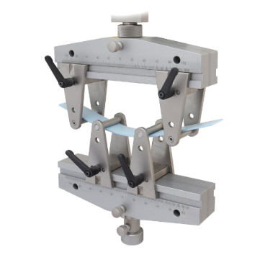
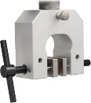




^{KOMPETAN-}
^{DuoCol}
^{R&D Assistant!}
WE ARE ALWAYS WITH YOU WITH REMOTE DESKTOP CONNECTION!
Online training and technical support are provided.
^{INTEGRATED TOUCH COMPUTER}
It is offered as standard in Kompetan series.
All controls are now very fast and at your fingertips.
FREE FALCON PRO MATERIAL TESTING PROGRAM
It organizes your tests, creates your methods, provides your statistical data, and archives the results. It makes them accessible by providing historical search opportunities. After the data is converted into PDF, it can be shared via e-mail with a single click. This increases the analytical capabilities of the testing process.
A special test method can be defined.
Customize your test cycles. Record parameters such as preload, load hold, test termination modes, displacement or force cycles.
Define reminder information such as user name, product name, standard name in the information boxes.
Secure your test results with automatic database records.
AUTOMATIC LOADCELL RECOGNITION SYSTEM
Get high sensitivity at low loads by connecting different load cells without the need for a device.
^{WHY KOMPETAN?}
This is the series we produce for laboratories that have completed Quality Control and moved on to the Research and Development step. It has a modular design consisting of compact components that collectively enable versatile testing of various materials.
^{ADVANTAGES}
It automatically backs up the analyses performed under a specific archive. It records all tests second by second with user-defined archiving according to GLP rules. System can go back to the tests performed and repeat the test. It has a special touch screen mounted on the device case. It makes it possible to obtain more sensitivity for low loads by adding an optional double-stage load cell. Since the series using the most advanced PLC and load cells provides extremely high data transfer, it is possible to obtain very sensitive graphics. It can work fully compatible with our own production or different extensometers.
⁵
^{YEARS}
^{WARRANTY}
info@labomak.com.tr +90 212 438 18 26
İkitelli OSB Sefaköy San. Sit. 16 blok No: 11-13, 34490 Başakşehir/İstanbul

Slide 2

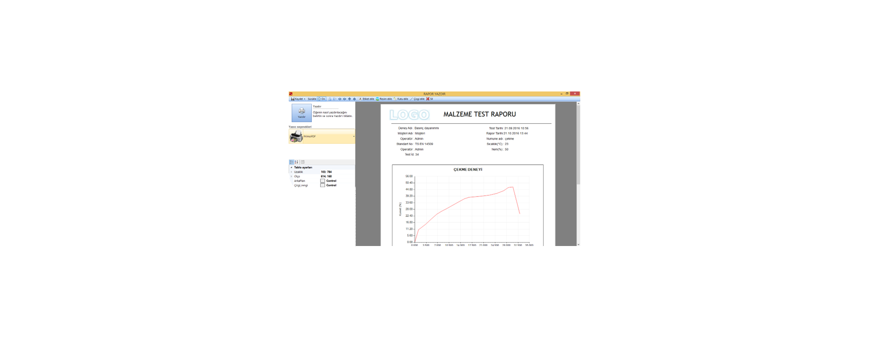

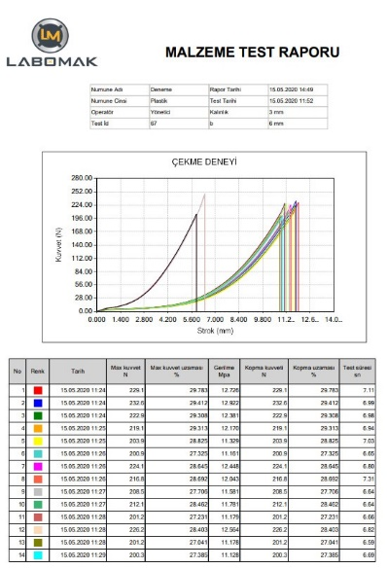

^{KOMPETAN – DUOCOL}
^{TENSILE AND COMPRESSION}
^{TESTING MACHINES}
^{TECHNICAL SPECIFICATIONS}
Digital or touch screen/touch computer.
Breakage / Stopping depending on breakage or distance.
Robust and reliable structure that does not require special maintenance.
^{Automatic fast reverse.}
^{Emergency stop button.}
^{3 column, 1 screw system.}
^{Precision ±0.5%.}
Measurement in tension or compression direction.
^{Standard FalconPro software.}
Maximum movement of 970 mm excluding the jaw in the long model, 500 mm movement in the short model.
Max . sample diameter ( width ) 180 mm.
Electronic and mechanical overload protection system.
^{High resolution Servo Motor,}
Easy to change jaws and fixtures thanks to the pin system.
Capacity 20 / 50 / 100 / 200 kN / 500 kN
^{Speed range(mm/min): 0.01-500}
Force sensitivity: 1 / 5000 Class 0.5
^{Force resolution: 1/100000}
Force measurement range: 1%-100%
^{Movement resolution(mm): 0.001}
Movement distance(mm without jaw): 1000
^{Column width(mm): 400}
RS232 connection / USB connection
^{COMPLIANCE}
Perform tensile, compression, bending, folding, cutting, drilling, etc. tests in the most economical way by using additional equipment according to EN, ISO, ASTM standards and any request.
Easily convert your results to different units. Perform reliable tests with our standard or custom grip fixtures.
Prepare test presentations with the simple, fast and professional Falcon interface.
^{STANDARD FALCON PRO SOFTWARE}
^{Instant graphic drawing}
Testing opportunity in all units
Save the test report in PDF format
Standard tensile compression 3 point bending test software
10 sample sequential testing and statistics
Curve overlay of up to 10 tests in different colors on a single graph
Extensometer can be connected when Falcon Pro software is purchased .
Technical assistance via remote desktop connection
^{Recording test results}
^{Automatic database backup}
Login to the program with password
Admin settings / staff authorization assignment determination
^{Record results in excel format}
^{Extensometer connection}
^{Defining a custom test method}
Sample specific test definition (create and call)
Body Capacity | 20 kN | 50kN | 100kN | 200kN
Loadcell Options | 2/5/10/20 kN | 30/50 kN | 50/100 kN | 50/100/200 kN
Height(cm) | 148 | 170 | 175 | 225
Width(cm) | 72 | 82 | 86 | 101
Depth(cm) | 48 | 57 | 60 | 800
Weight(kg) | 95 | 205 | 275 | 750
Voltage/Power | 220V±10% 50 Hz / 0.75 kW | 220V±10% 50 Hz / 1.5 kW | 220V±10% 50 Hz / 1.5 kW | 3x380V±10% 50 Hz / 4 kW
info@labomak.com.tr +90 212 438 18 26
^{www.labomak.com.tr}
İkitelli OSB Sefaköy San. Sit. 16 blok No: 11-13, 34490 Başakşehir/İstanbul

Slide 3

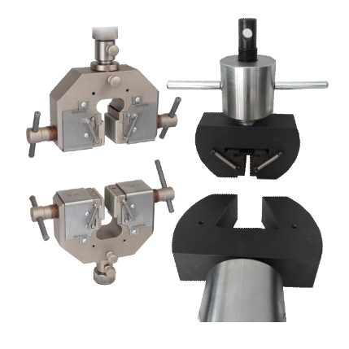
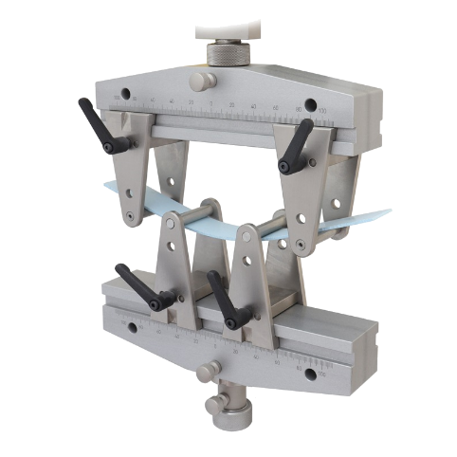
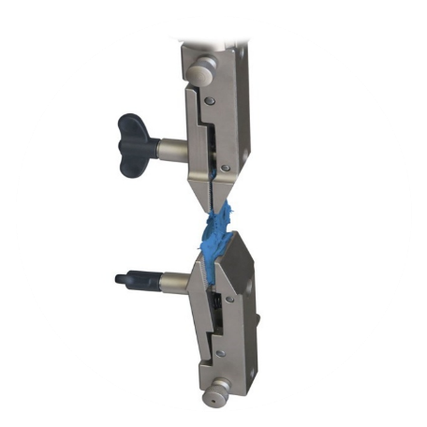
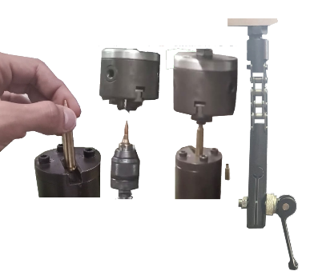
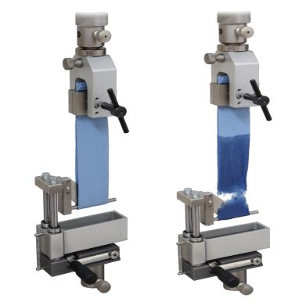
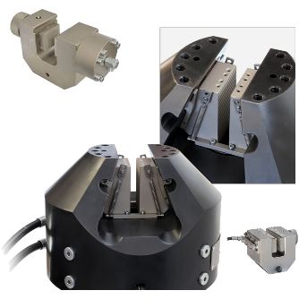
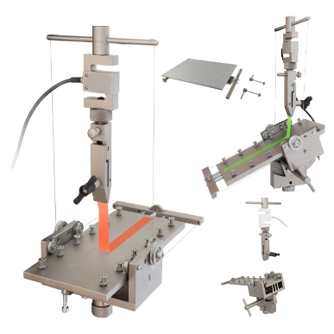
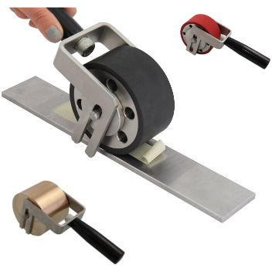
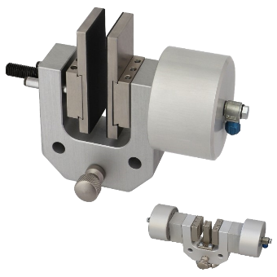
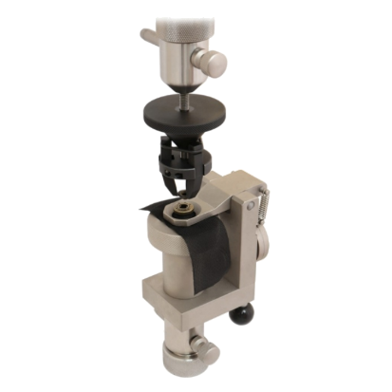
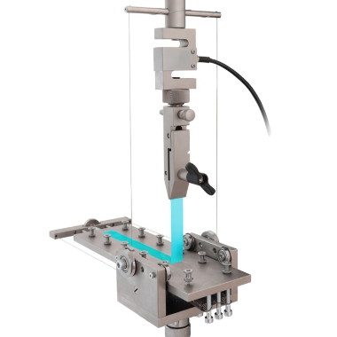
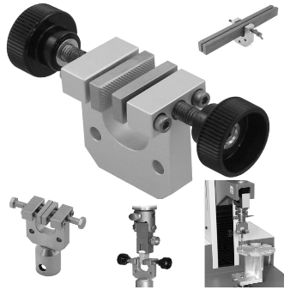
info@labomak.com.tr +90 212 438 18 26
^{www.labomak.com.tr}
İkitelli OSB Sefaköy San. Sit. 16 blok No: 11-13, 34490 Başakşehir/İstanbul

